Slide 1
Data Mining — E-commerce Customer Segmentation
Analisis Transaksi Penjualan & GMM Clustering
Muhammad Iqbal Fadel | Semester 6 | Juni 2026

Slide 2
Phase 1: Exploratory Data Analysis
12 visualisasi dari 522,601 transaksi

Slide 3
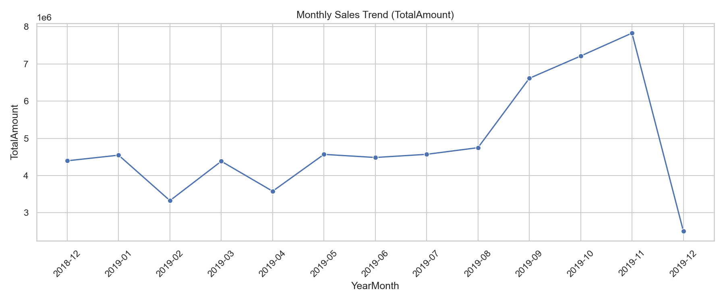
Monthly Sales Trend

Slide 4
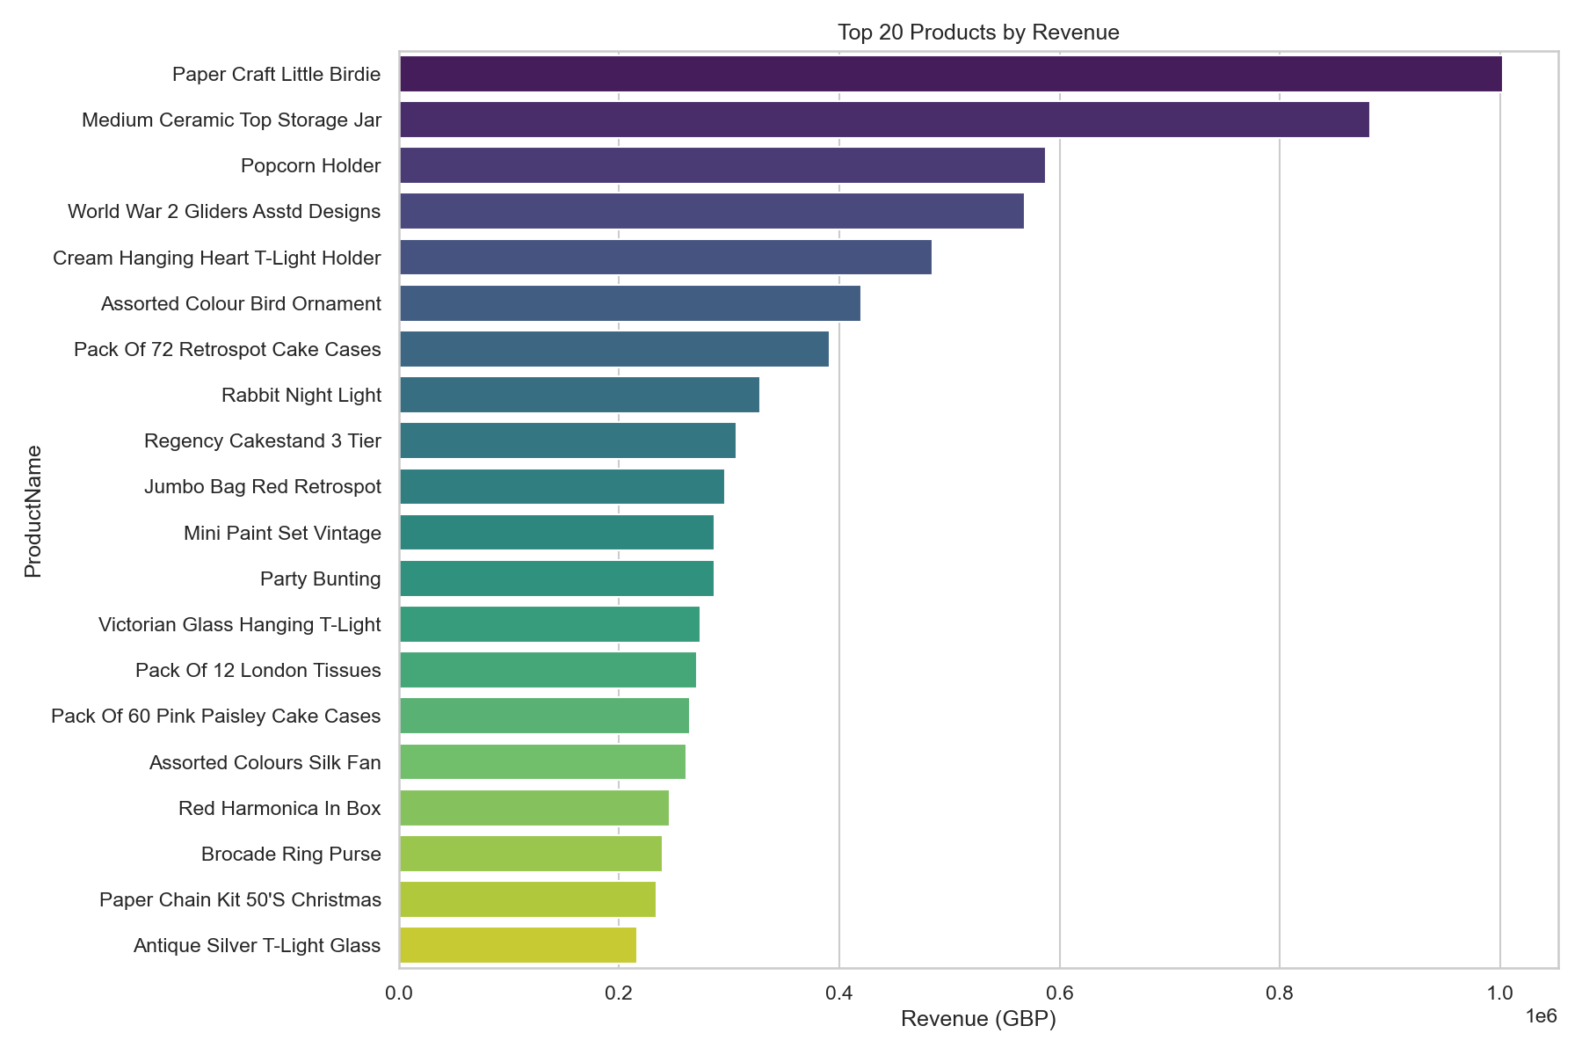
Top 20 Products by Revenue

Slide 5
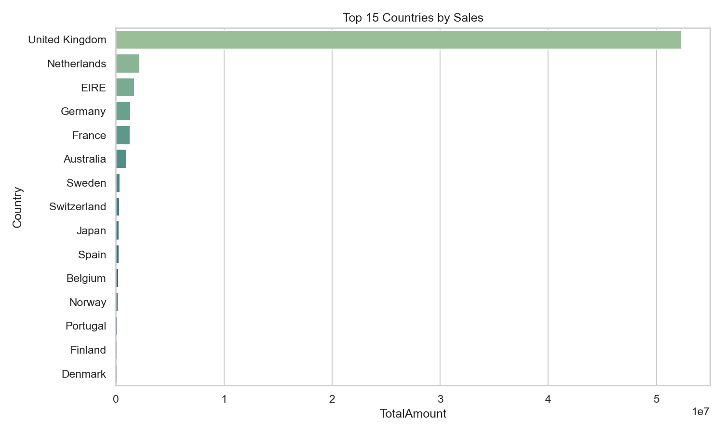
Top 15 Countries by Sales

Slide 6
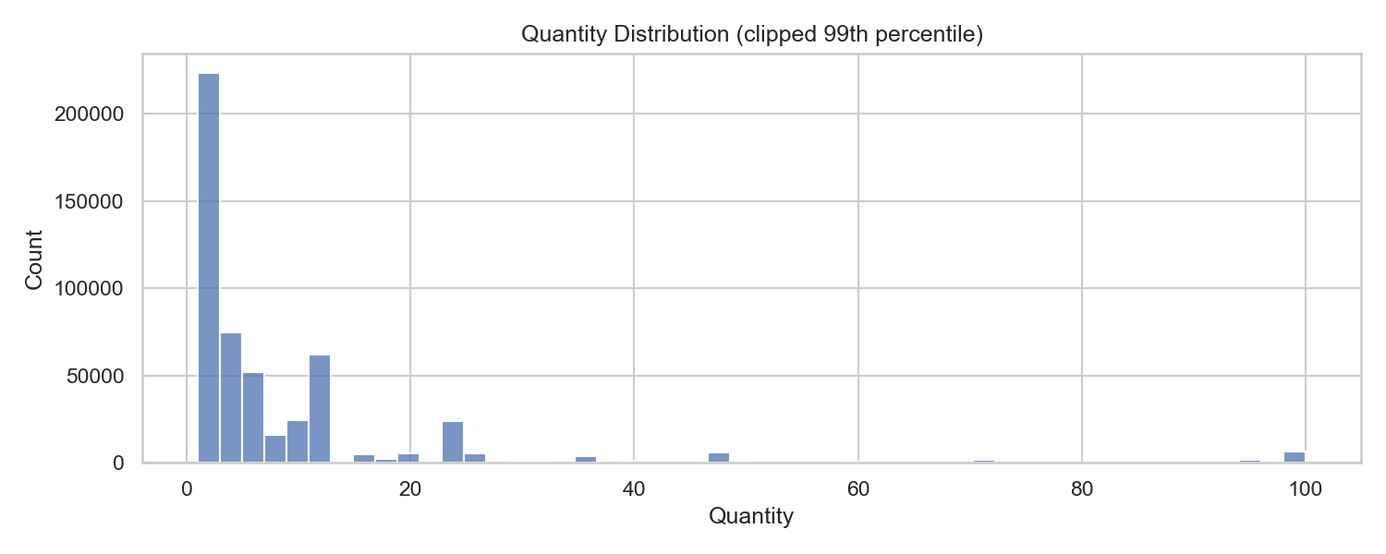
Quantity Distribution

Slide 7
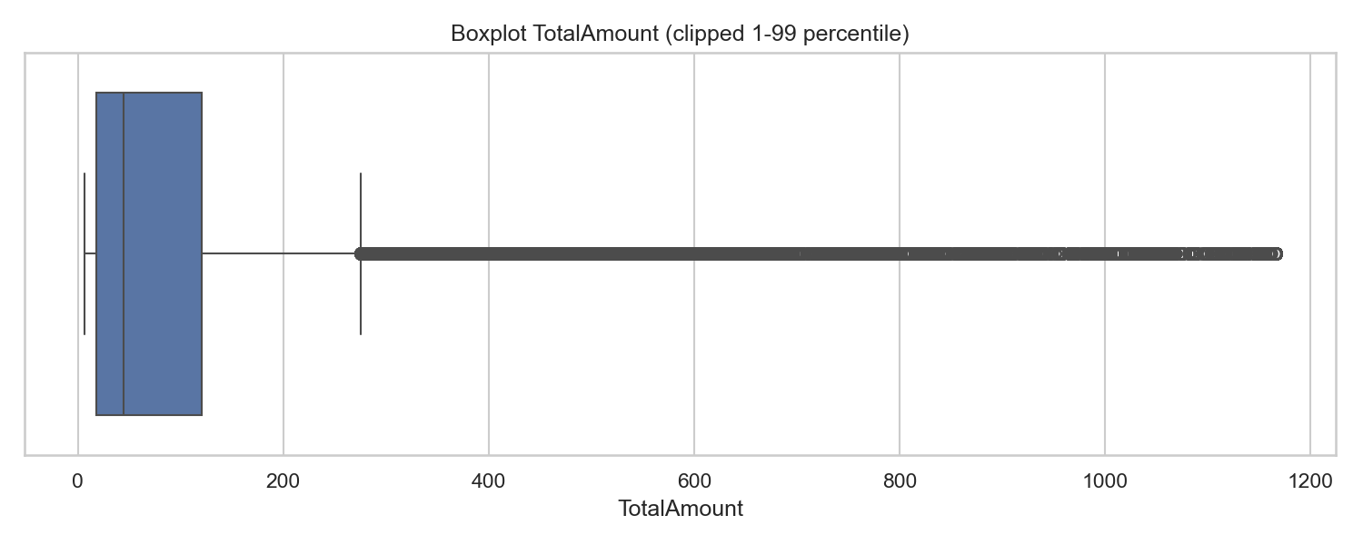
Total Amount Boxplot (Outlier Detection)

Slide 8
Phase 2: RFM Customer Segmentation
5 segmen pelanggan berdasarkan Recency, Frequency, Monetary

Slide 9
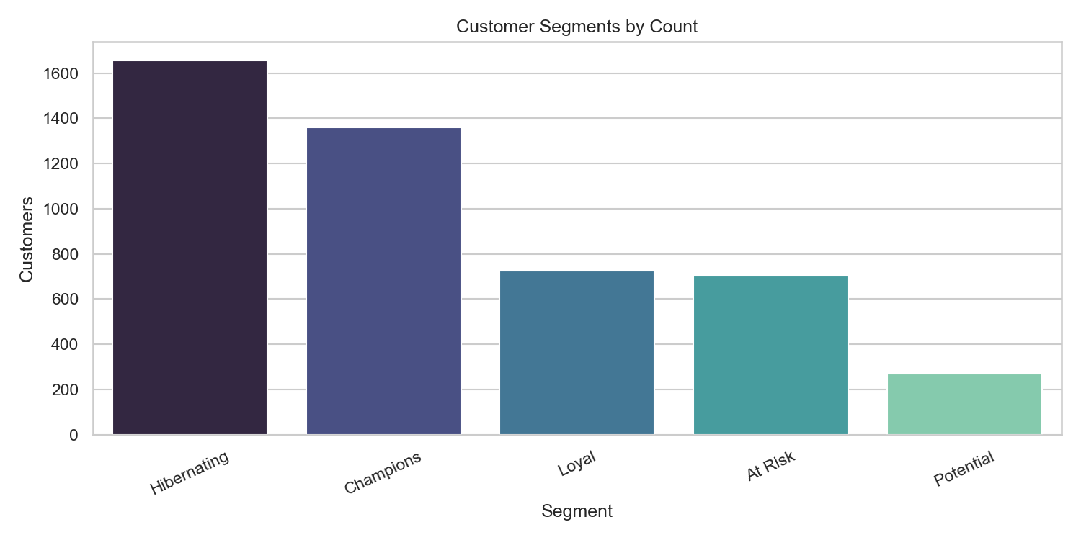
RFM Segment Distribution

Slide 10
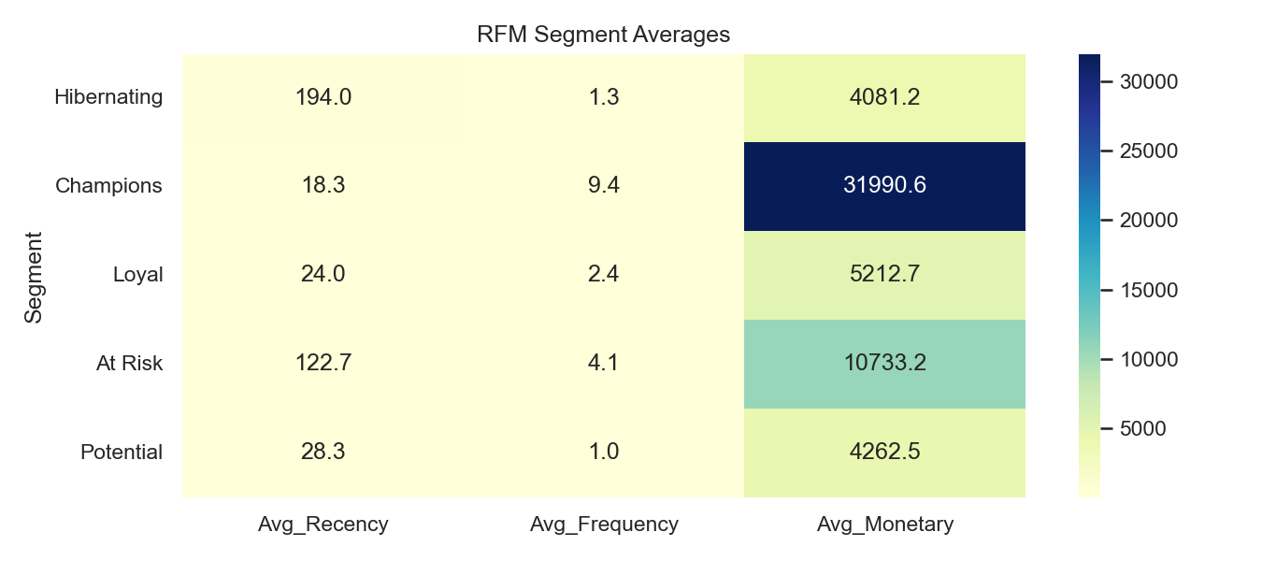
RFM Segment Averages Heatmap

Slide 11
Phase 3: Advanced Analytics
Basket Analysis, Cohort Retention, Sales Forecasting

Slide 12
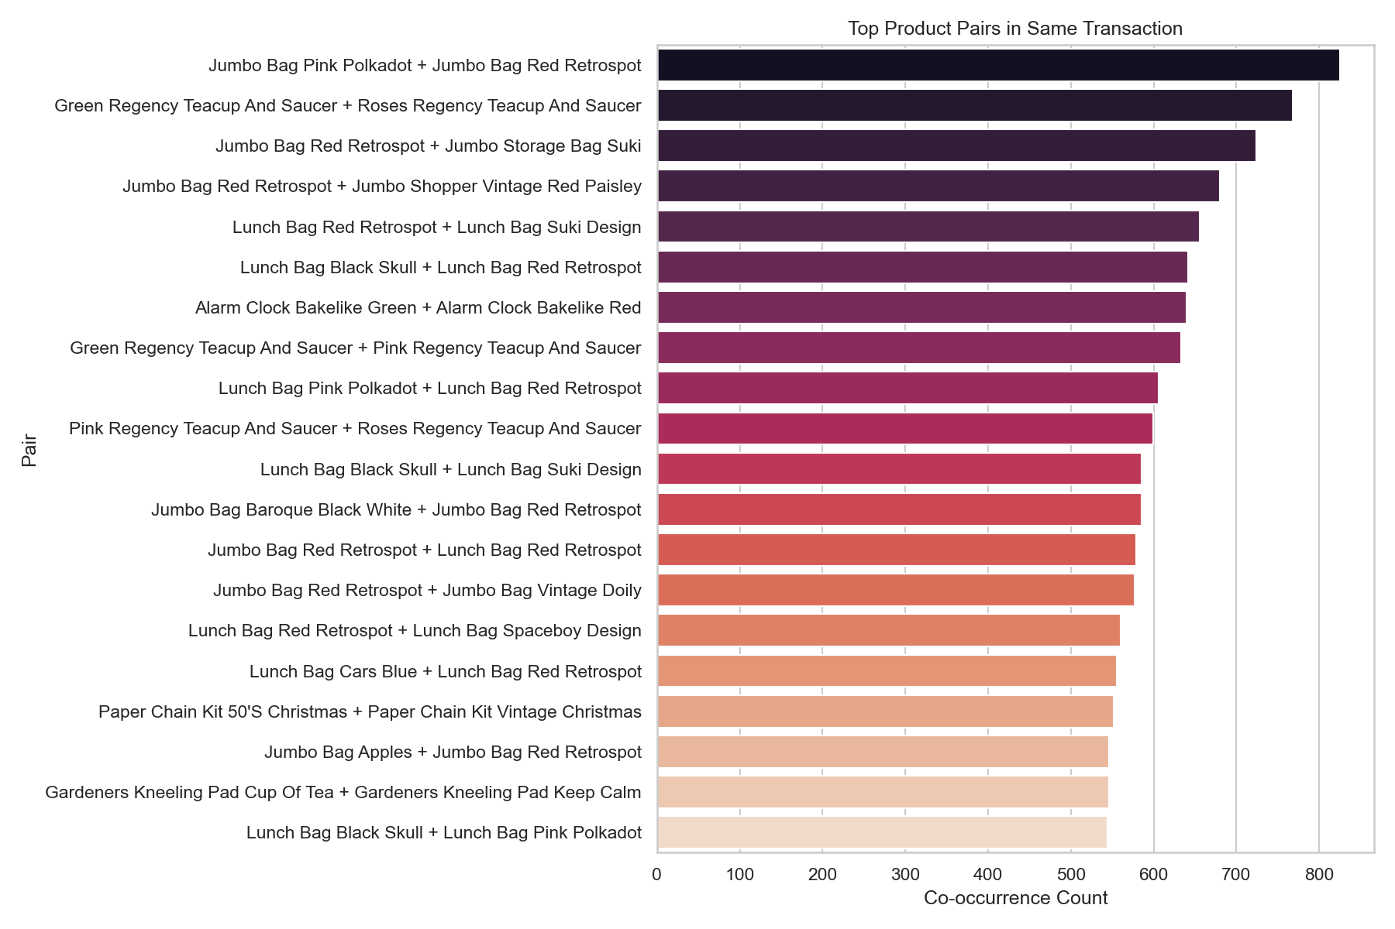
Top Product Pairs (Basket Analysis)

Slide 13
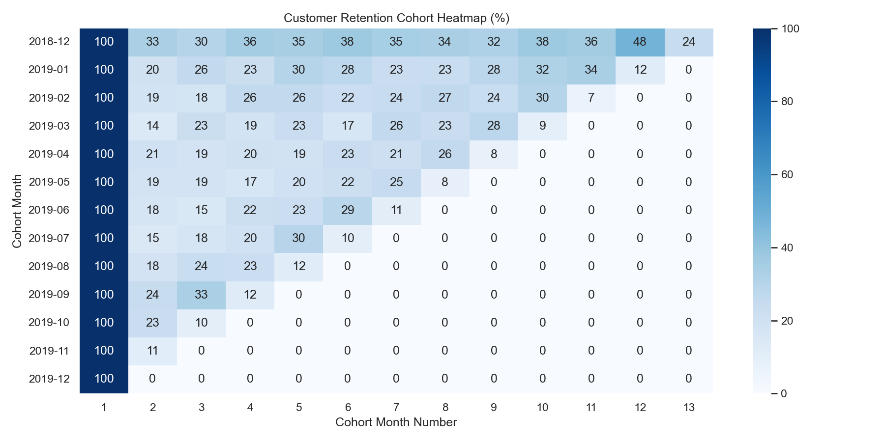
Customer Retention Cohort Heatmap

Slide 14
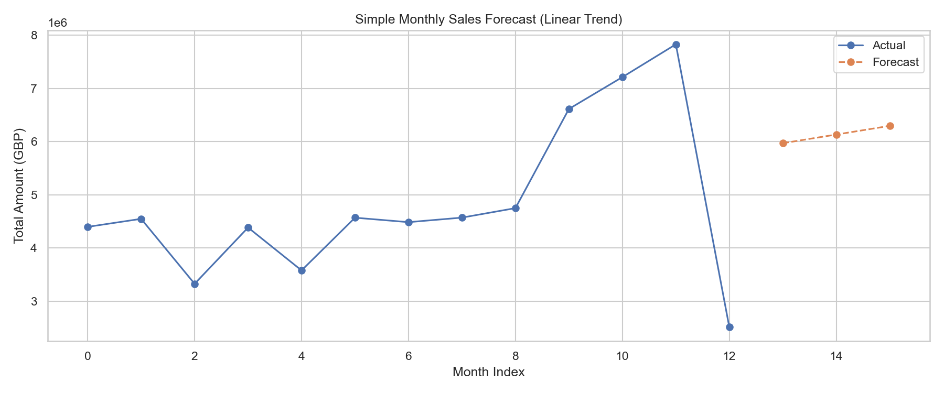
Monthly Sales Forecast (Linear Trend)

Slide 15
Phase 4: Machine Learning — Baseline RandomForest
Cross-validation, Feature Importance, ROC AUC

Slide 16
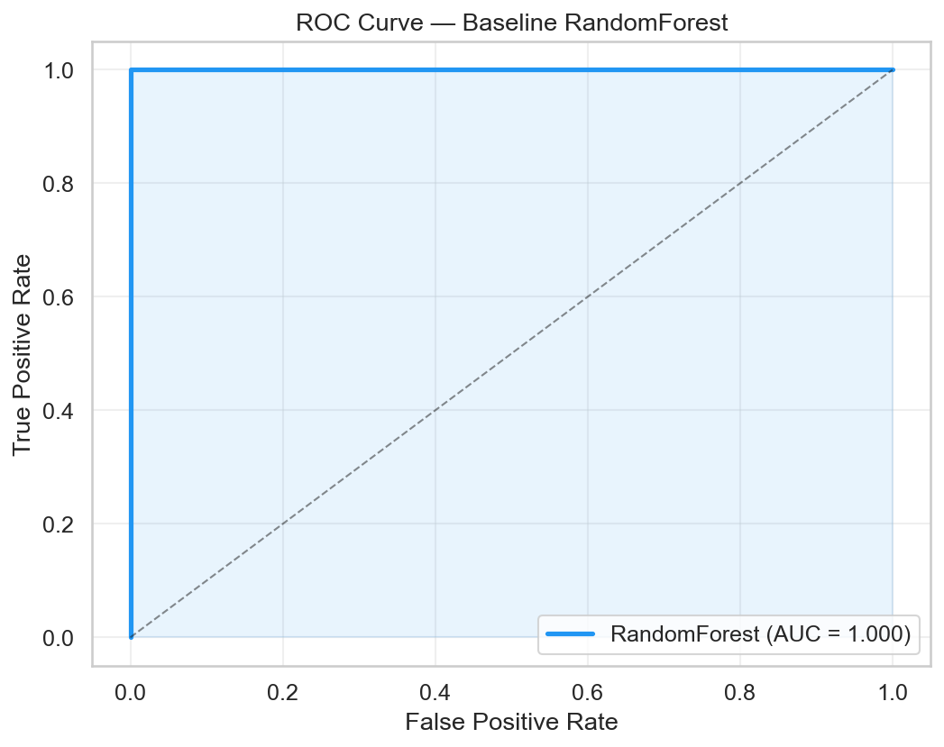
ROC Curve — Baseline RandomForest

Slide 17
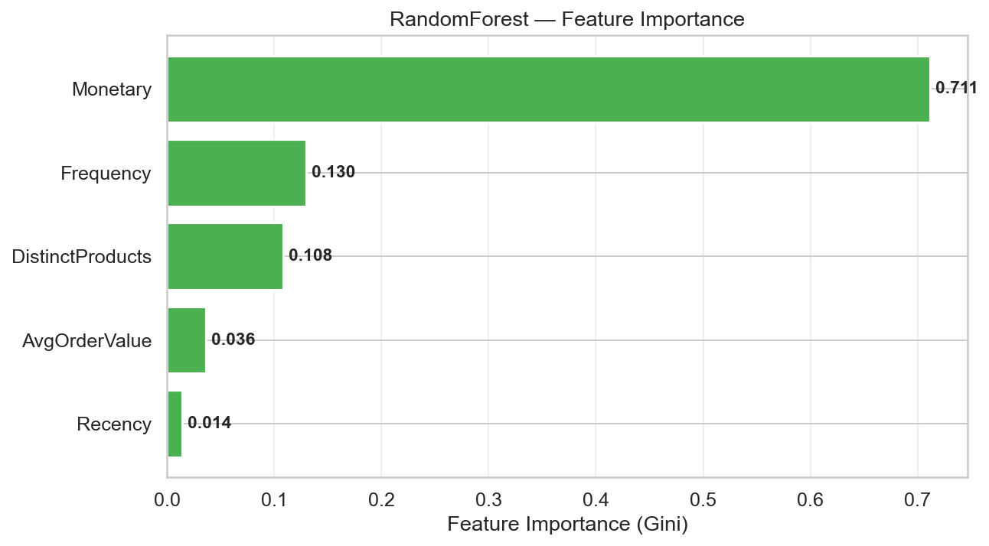
Feature Importance (Gini)

Slide 18
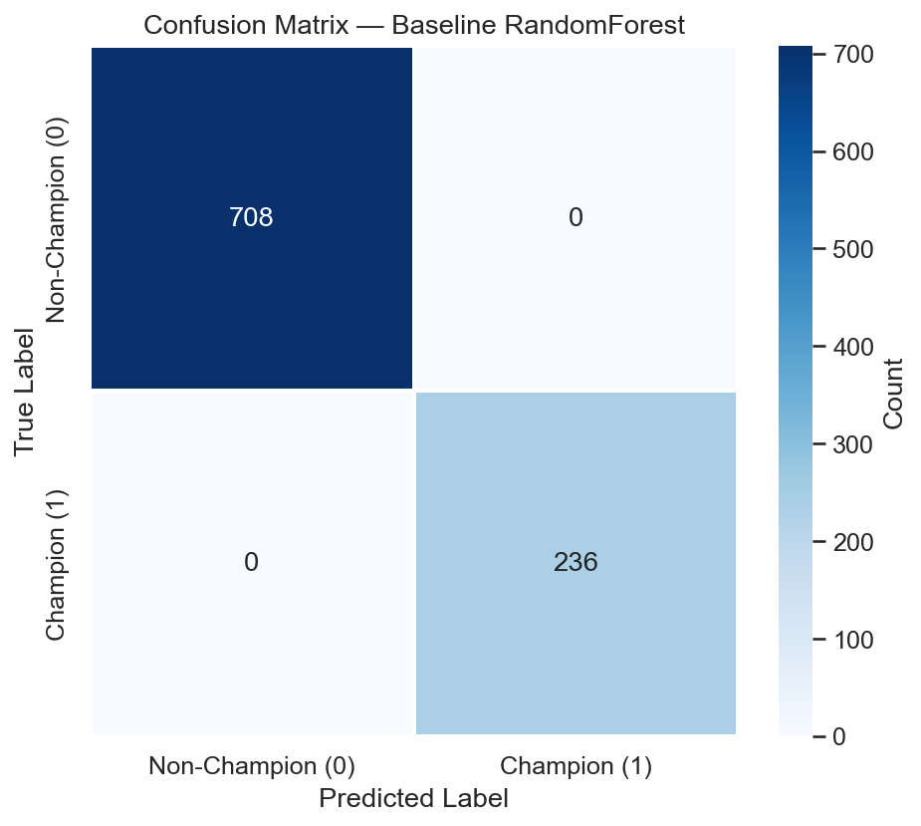
Confusion Matrix

Slide 19
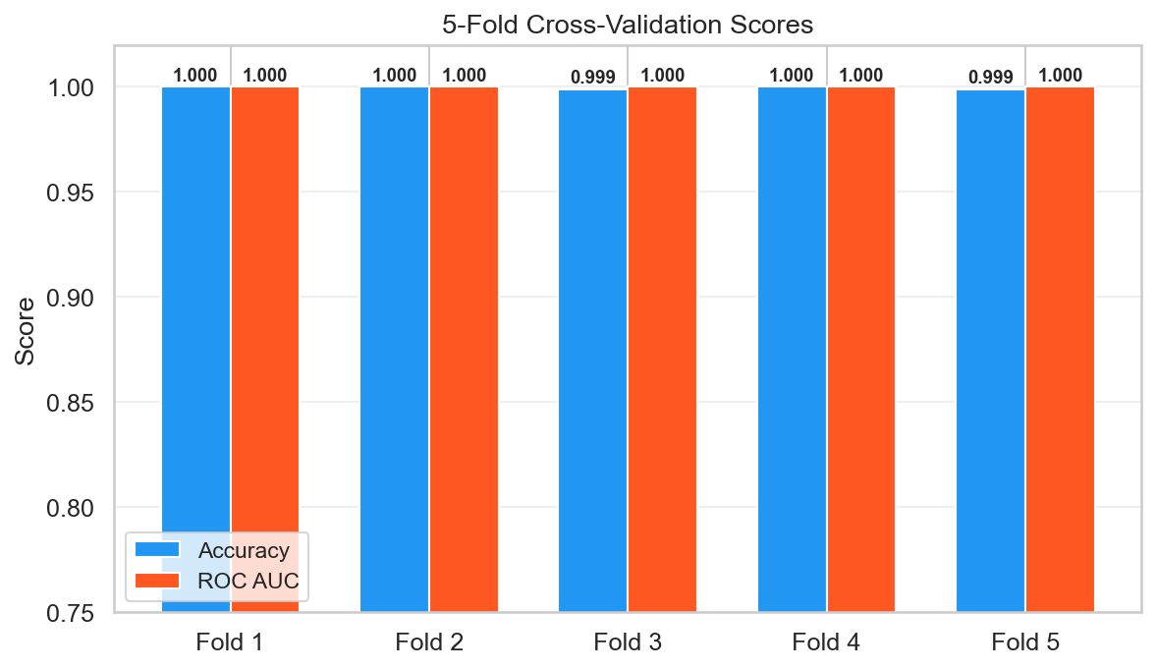
5-Fold Cross-Validation Scores

Slide 20
Phase 5: Feature Selection Analysis
Correlation-based, Backward Elimination, Model-based

Slide 21
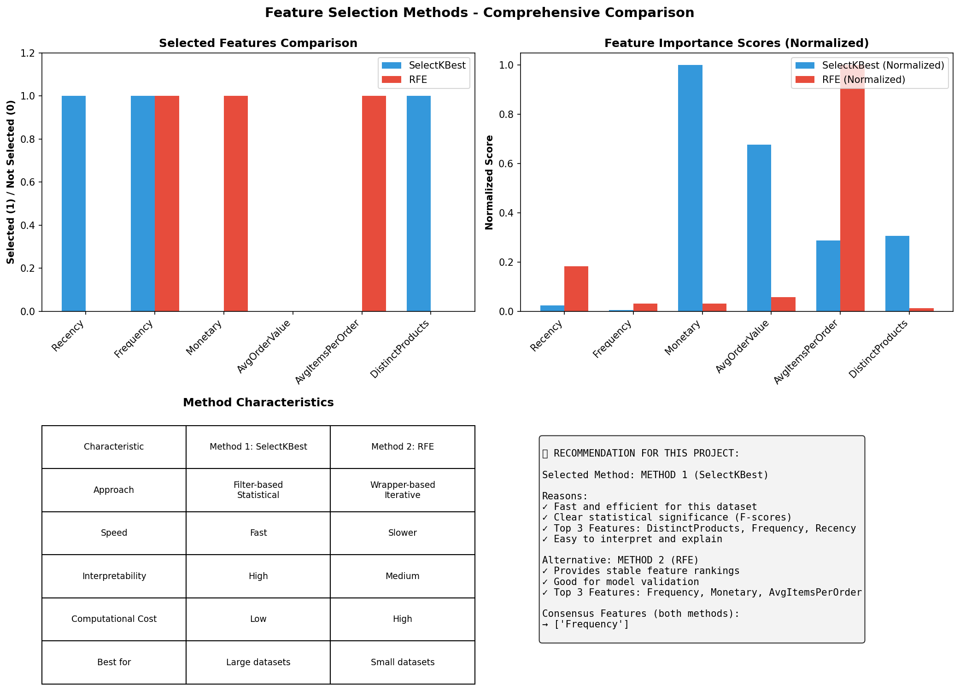
Feature Selection Comparison

Slide 22
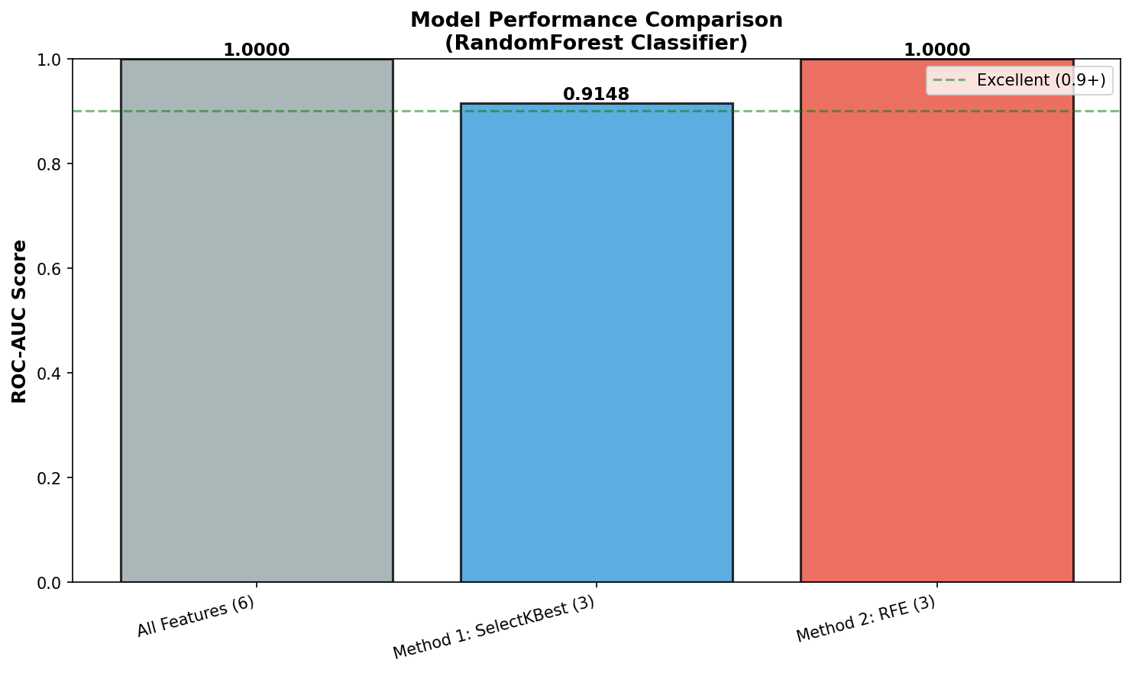
Model Performance Comparison

Slide 23
HIGHLIGHT: GMM Clustering
Gaussian Mixture Model — Probabilistic Customer Segmentation
9 cluster optimal via BIC/AIC | 7 visualisasi profesional

Slide 24
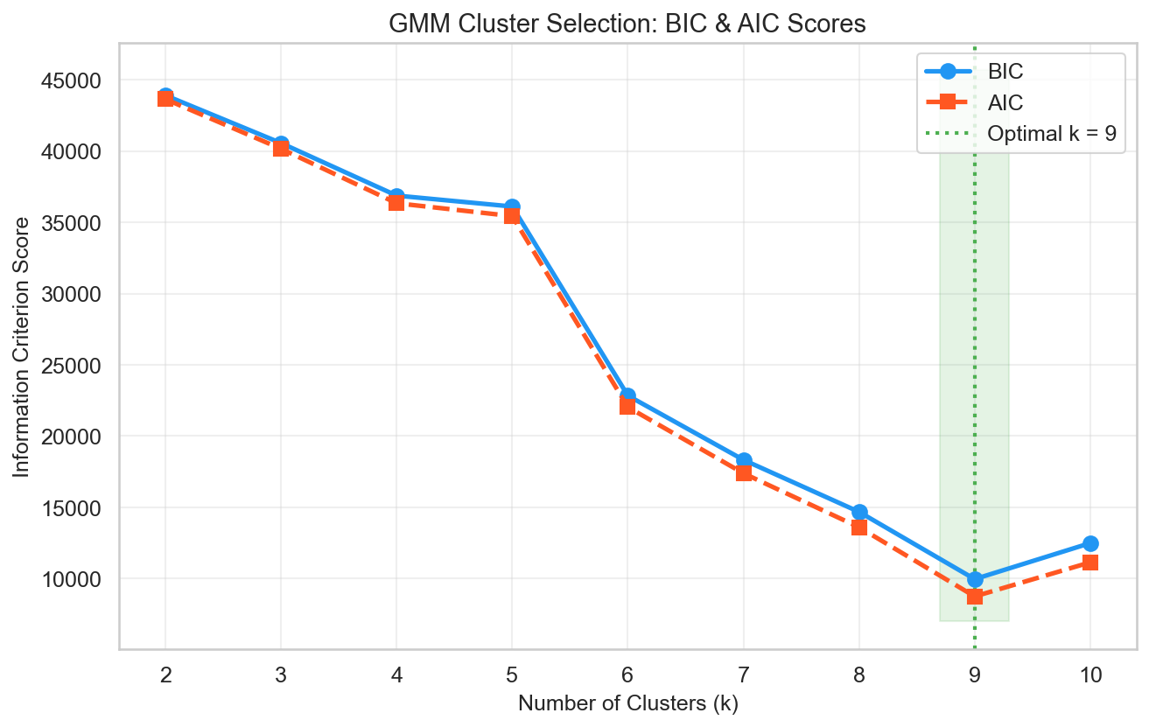
GMM: BIC & AIC Cluster Selection

Slide 25
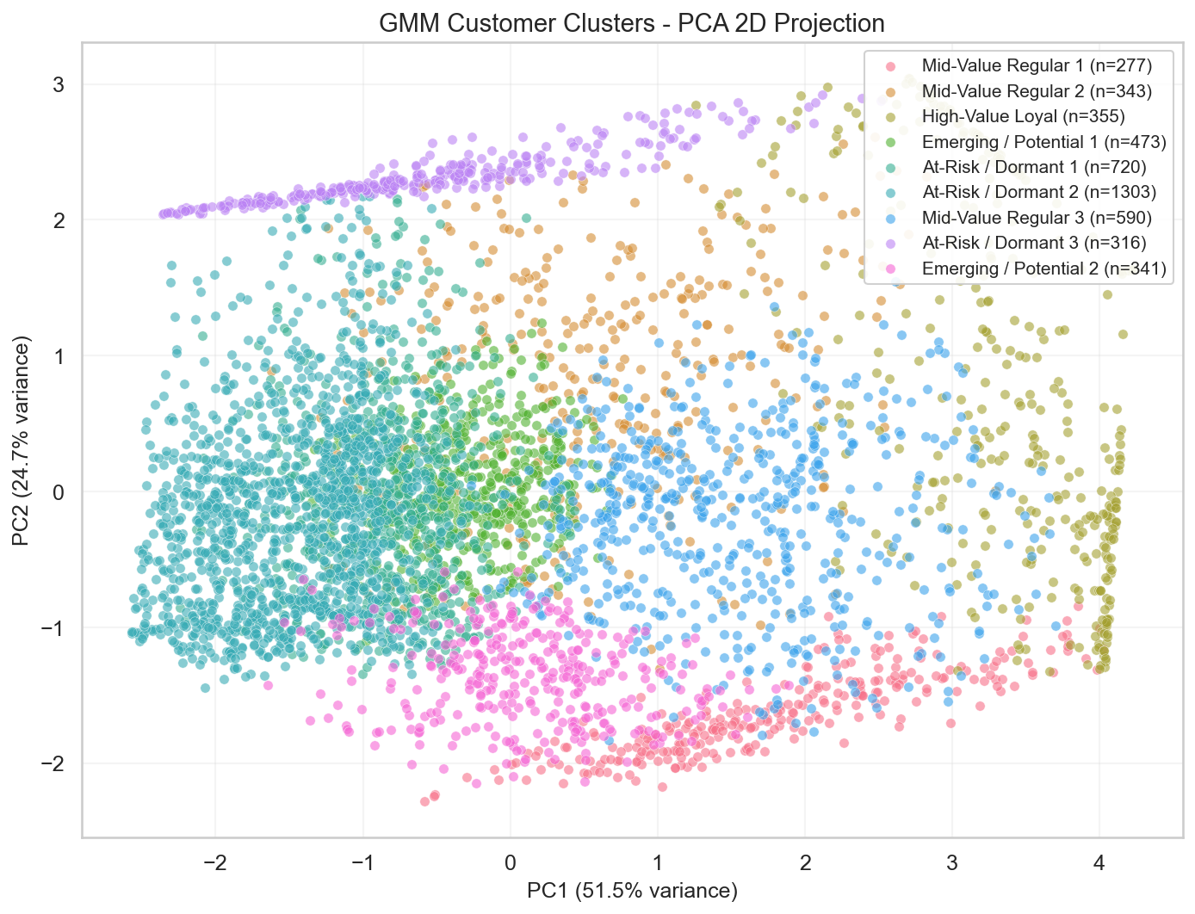
GMM: PCA 2D Projection

Slide 26
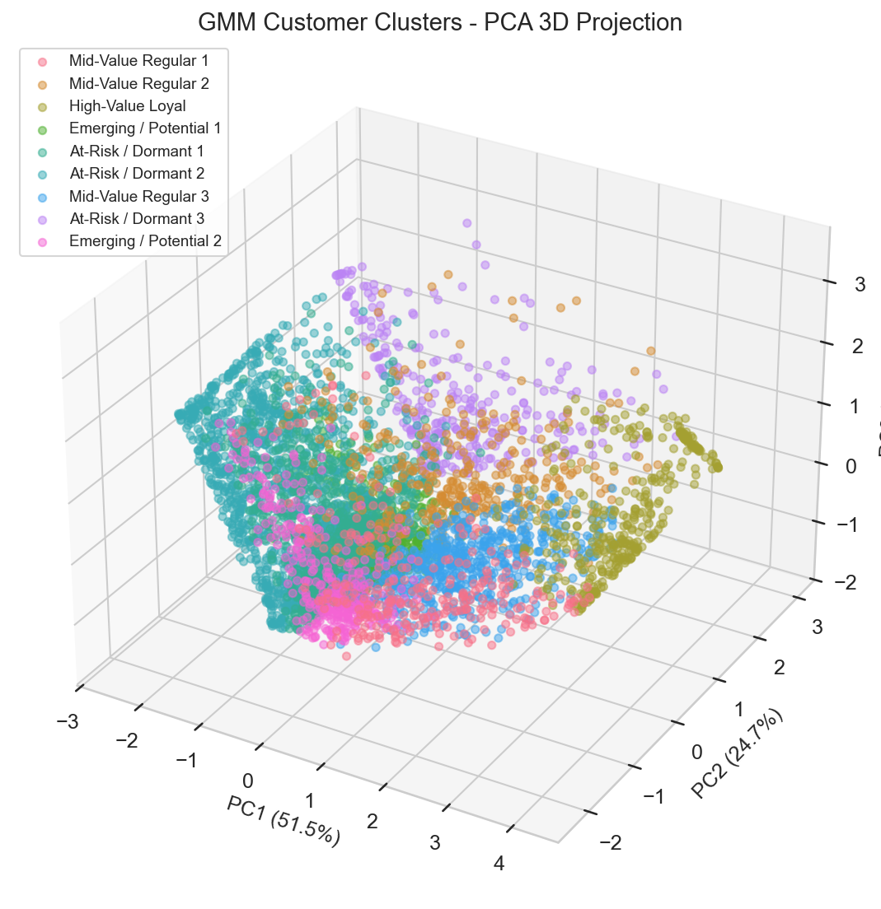
GMM: PCA 3D Projection

Slide 27
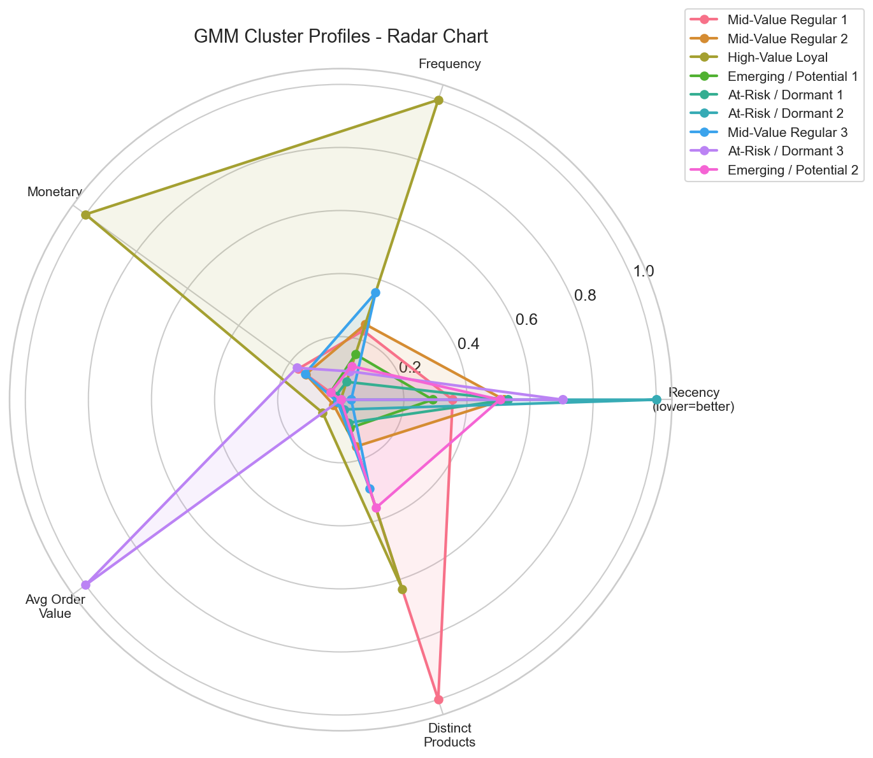
GMM: Cluster Profiles — Radar Chart

Slide 28
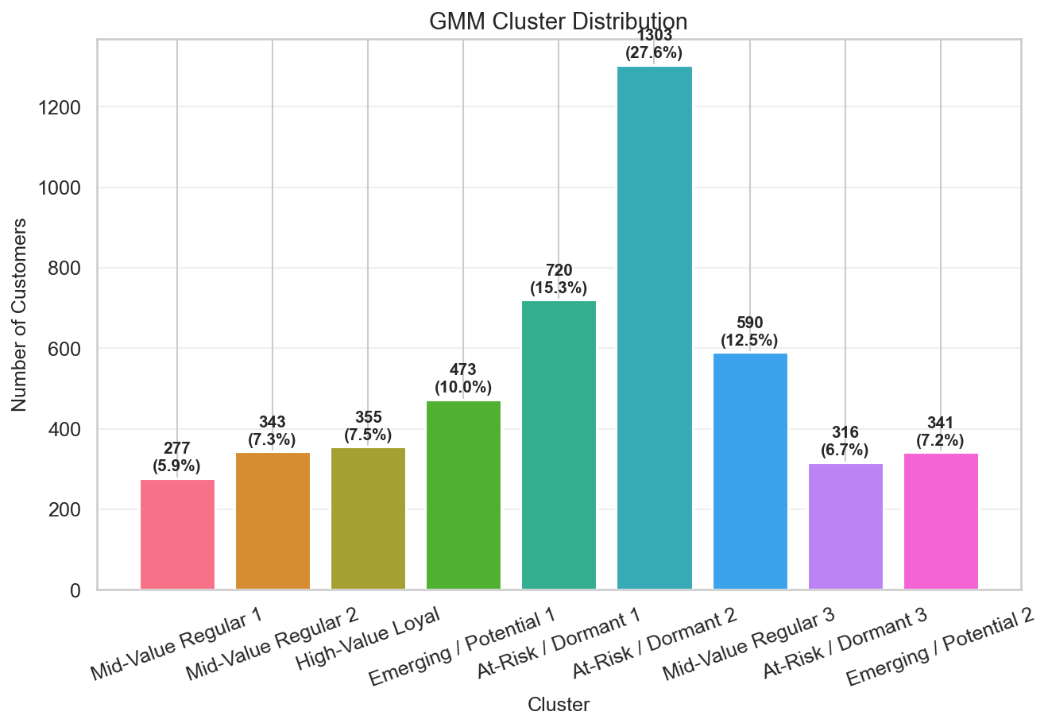
GMM: Cluster Distribution

Slide 29
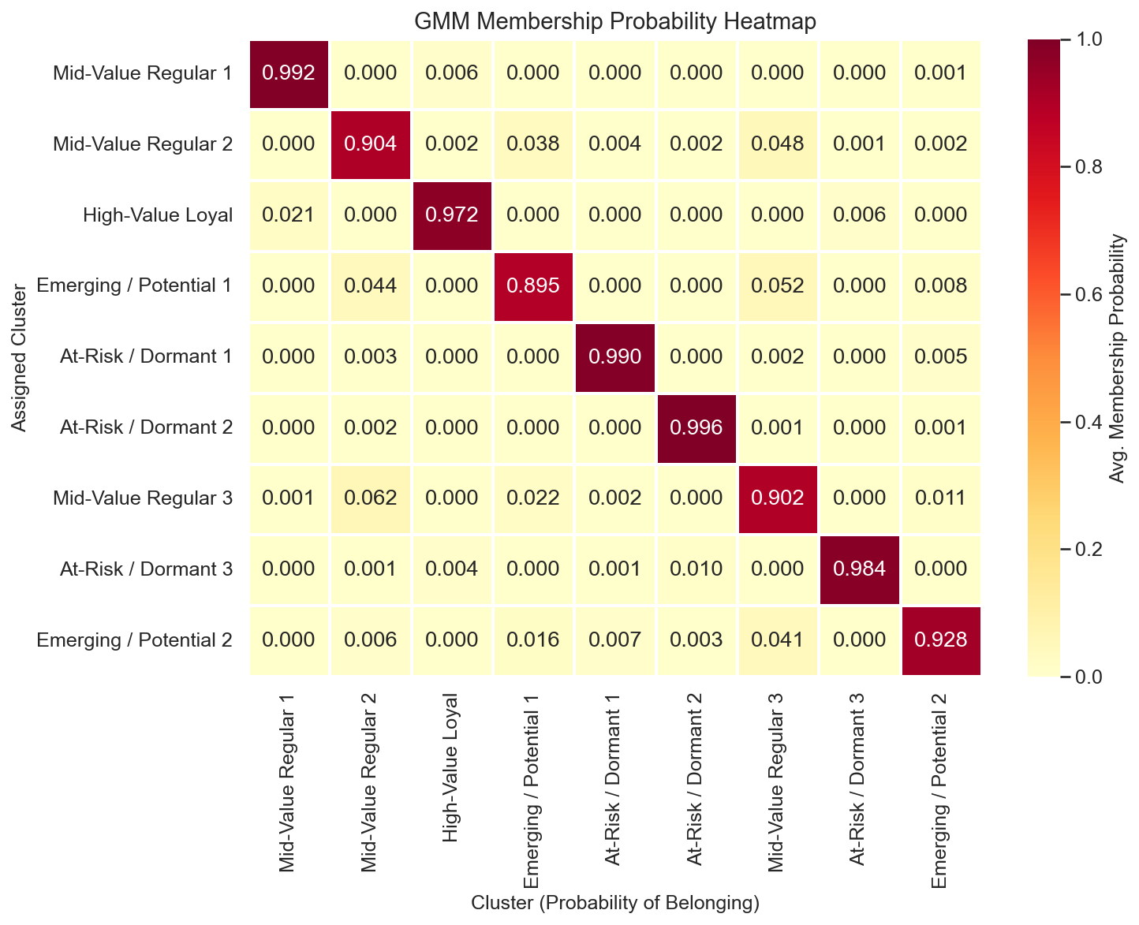
GMM: Membership Probability Heatmap

Slide 30
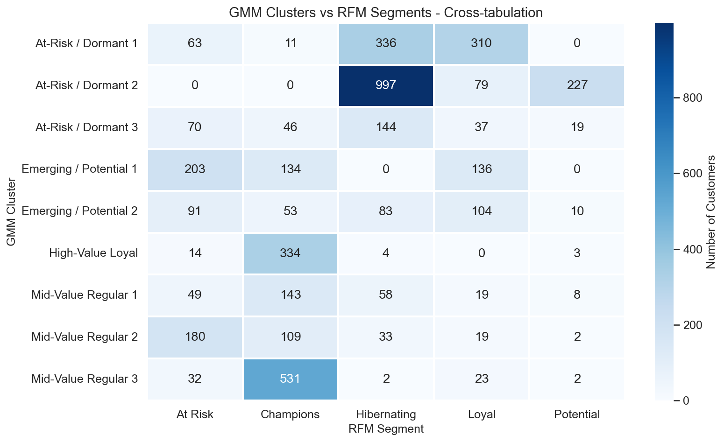
GMM vs RFM — Cross-tabulation Comparison

